Slide 1
FrontEnd - Elements
Pravin Y Pawar

Slide 2

Frontend
Elements
Not just about the beautification of the web / mobile interfaces
Involves elements for
Content Structure
Styling
Interaction
Deals with
Rendering of the content on the browsers / within apps
Beautification of content rendered
Interaction carried out by user on web pages / mobile apps
Building blocks – HTML + CSS + JS!

Slide 3
Content Structure
Markup
Structure of the page is
the foundation of websites
essential for search engine optimization
vital to provide the style and the interaction that the reader will ultimately use
Hyper Text Meta Language (HTML)
will be at the very center of it all regardless of how complex the site is
uses tags, as opposed to a programming language, in order to identify all the various types of content out there on every single webpage
For example, in a newspaper article, a header, sub header, text body and other things are present
HTML works in the exact same way to label all the stuff on the webpage, except it uses HTML tags
even a JavaScript webpage, is comprised of HTML tags corresponding to each element on the webpage and every single content type is bundled into HTML tags as well.

Slide 4
Styling
Cascading Style Sheets
A core functionality of front-end development
lays out the page and give it both its unique visual flair and a clear, user-friendly view to allow readers
An important aspect of styling is checking across several browsers and to write concise, terse code that is
specific yet generic at the same time
displays well in as many renderers as possible
CSS determines how all the HTML elements must appear on the frontend
HTML gives all of the raw tools necessary to structure webpage
CSS allows to style everything so it will appear to the user exactly the way you would like it to

Slide 5
Interaction
User Interaction and interaction with backend
JavaScript
User Interaction on page
Supported by all modern browsers
employed by pretty much every website in order to gain increased functionality and power
Used mainly for website content adjustment and to make the website itself act certain ways depending on the user’s actions
Used for creating call-to-action buttons, confirmation boxes and adding new details to current information
Dynamic Behavior
drastically improves a browser’s default actions and controls
helps in placing asynchronous requests to server side and render the response received

Slide 6
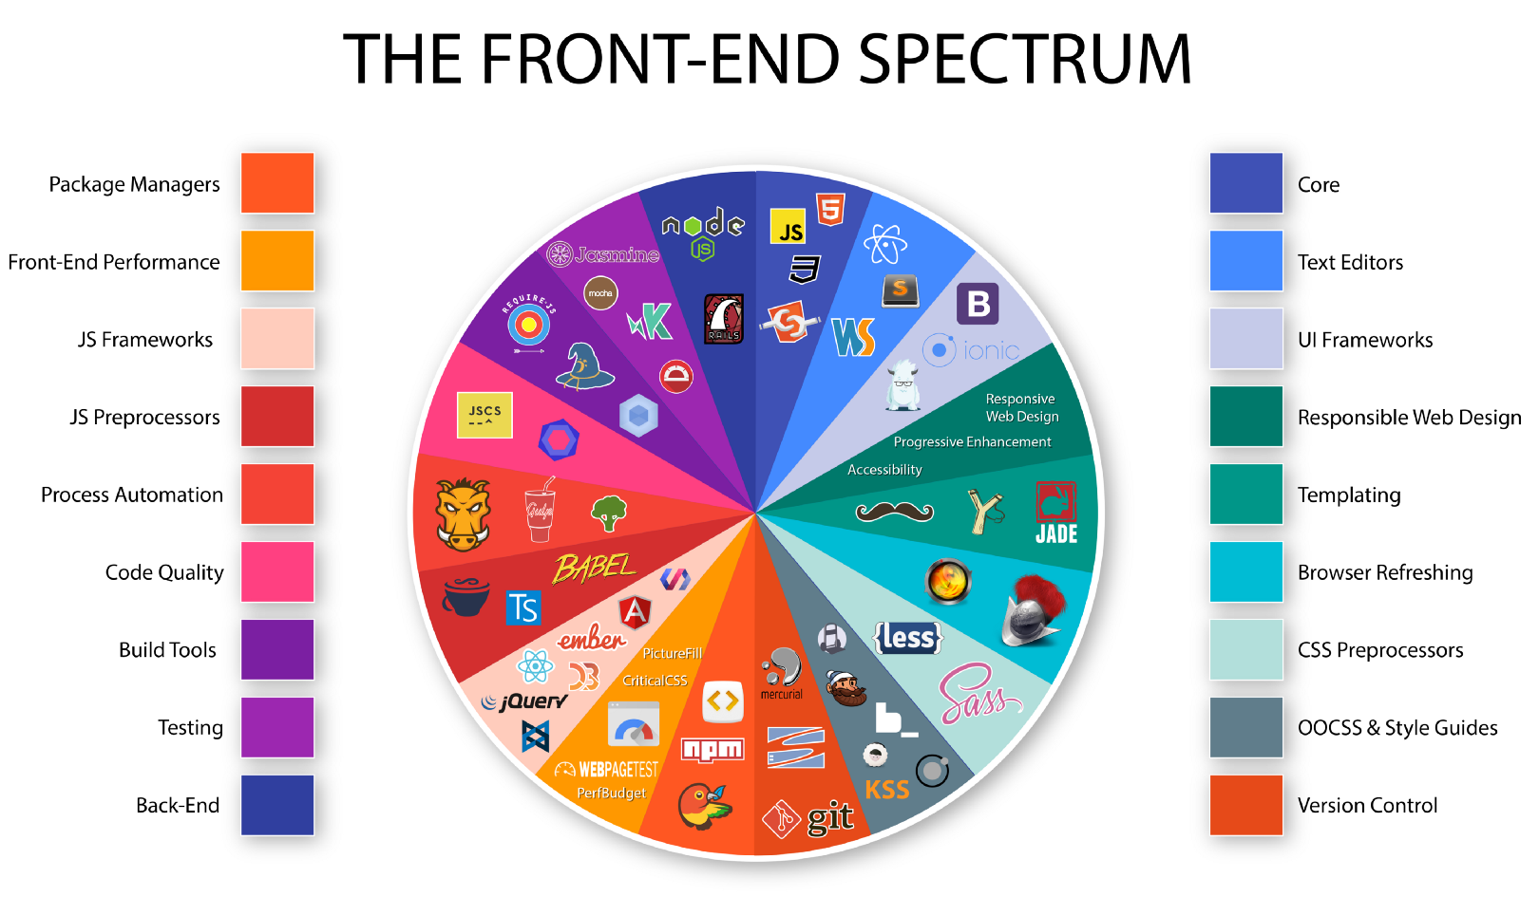
Frontend Tools Spectrum
Source : Medium

Slide 7
Thank You!
In our next session:

